Slide 1

Northern Star Scouting
2024 Popcorn Kickoff

Slide 2
Knight of the snack table
Bill
Anderson-Horecka
Staff advisor - Northern Star Scouting

Slide 3
Why do we sell?

Slide 4
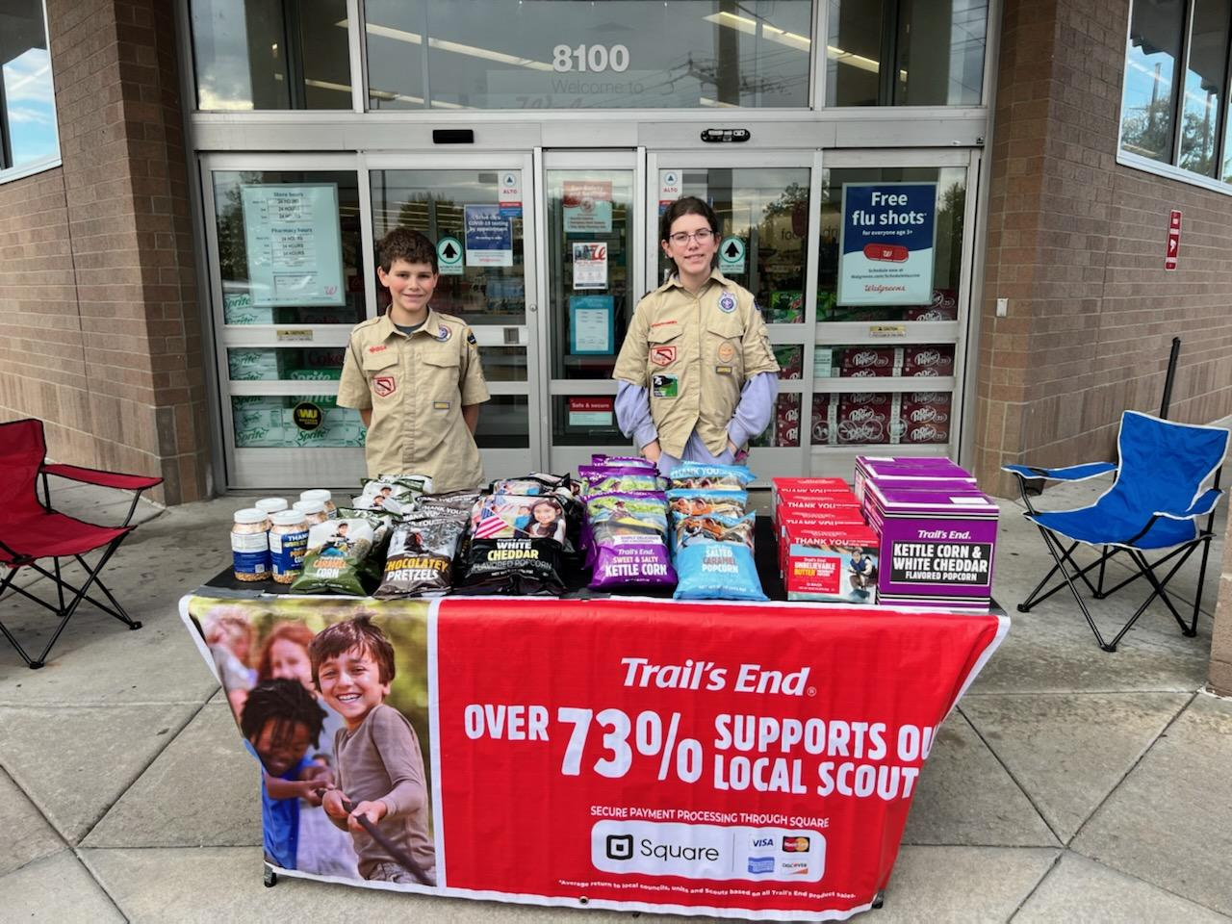
WHY do we sell Popcorn?
73% Return to Scouting
Fund our unit’s Scouting program
Scout character development
Improve our camps and council resources
OVER $1.75 million Returned to Northern Star Scouting in 2023

Slide 5

WHY do we sell Popcorn?
Benefits for Scouts
Personal growth program that can be applied to advancement opportunities and service projects.
Earn Amazon eGift Cards
  Millions of prize choices
  Scouts choose the prizes they want
Scouts Learn
How to help others around them
Public speaking & math skills
Salesmanship & perseverance
How to earn their own way
The value of hard work
How to handle rejection

Slide 6
Your Unit Earns
Commission Type: | Commission Percentage:
ONLINE DIRECT* | 35%
TRADITIONAL/WAGON/TAKE ORDER | 32%
Training Bonus | 3%
Cash Option (Troops and Crews) | 4%
*No rewards opt-out available.
Notes:
Opt-Out commissions generally provided 3% of benefit to the Scout, whereas Trail’s End Rewards provides an average of over 5%, and up to 20% benefit to the Scout!

Slide 7
Sale runs
Sept 20-Nov 3

Slide 8
Trail’s End Resources

Slide 9
Hear ye, hear ye! Who are thee?
Council: Northern Star Council
District: (Area within the Council, Alpha Letter)
Unit Type: (Pack, Troop, Crew, Post, Ship)
Unit Number: (4-Digit Number)

Slide 10
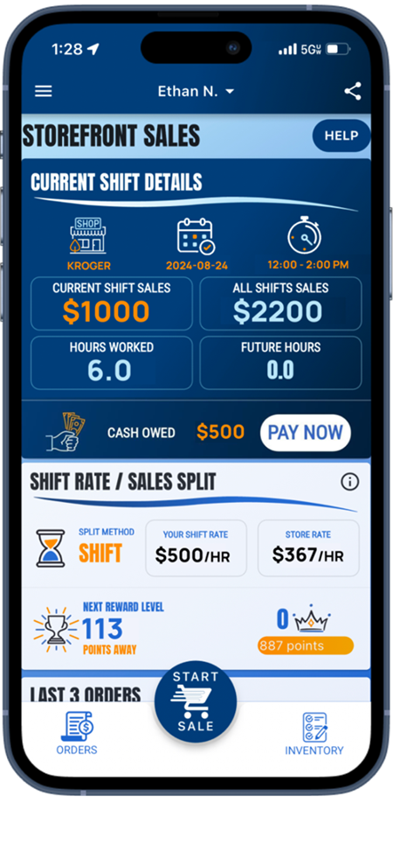
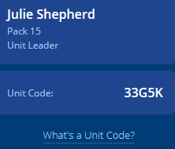
Trail’s End App
Save Time Managing Your Sale!
Scouts use the App to…
track and report real-time storefront, wagon and online sales
accept cash and credit cards
track inventory by Scout and storefront
schedule Scouts for storefronts.
Free Credit Card Processing
Powered by Square | Paid by Trail’s End
Available in Apple and Google Play Stores
New Scouts
Use Unit’s Trail’s End Code or their zip code to register.
Families can use one email for multiple accounts.
Returning Scouts
Sign in using 2023 username
Families: click name dropdown at top of screen to switch between accounts in the App

Slide 11
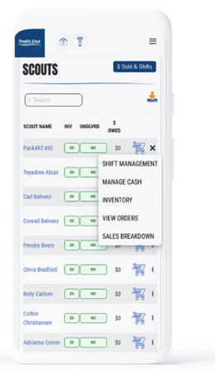
Trail’s End Leader Portal
Login at:
www.trails-end.com/leader
with your Trail’s End Leader account.
Your one-stop-shop for sale management!
Order Popcorn.
Invite their Scouts to register; manage Scout roster.
Easily set Unit and Scout goals.
View real time reporting of sales, inventory and cash management; all in one place.
Unit-to-Unit product transfers. No Council intervention needed.
Create, schedule, and manage storefront sites and shifts.

Slide 12
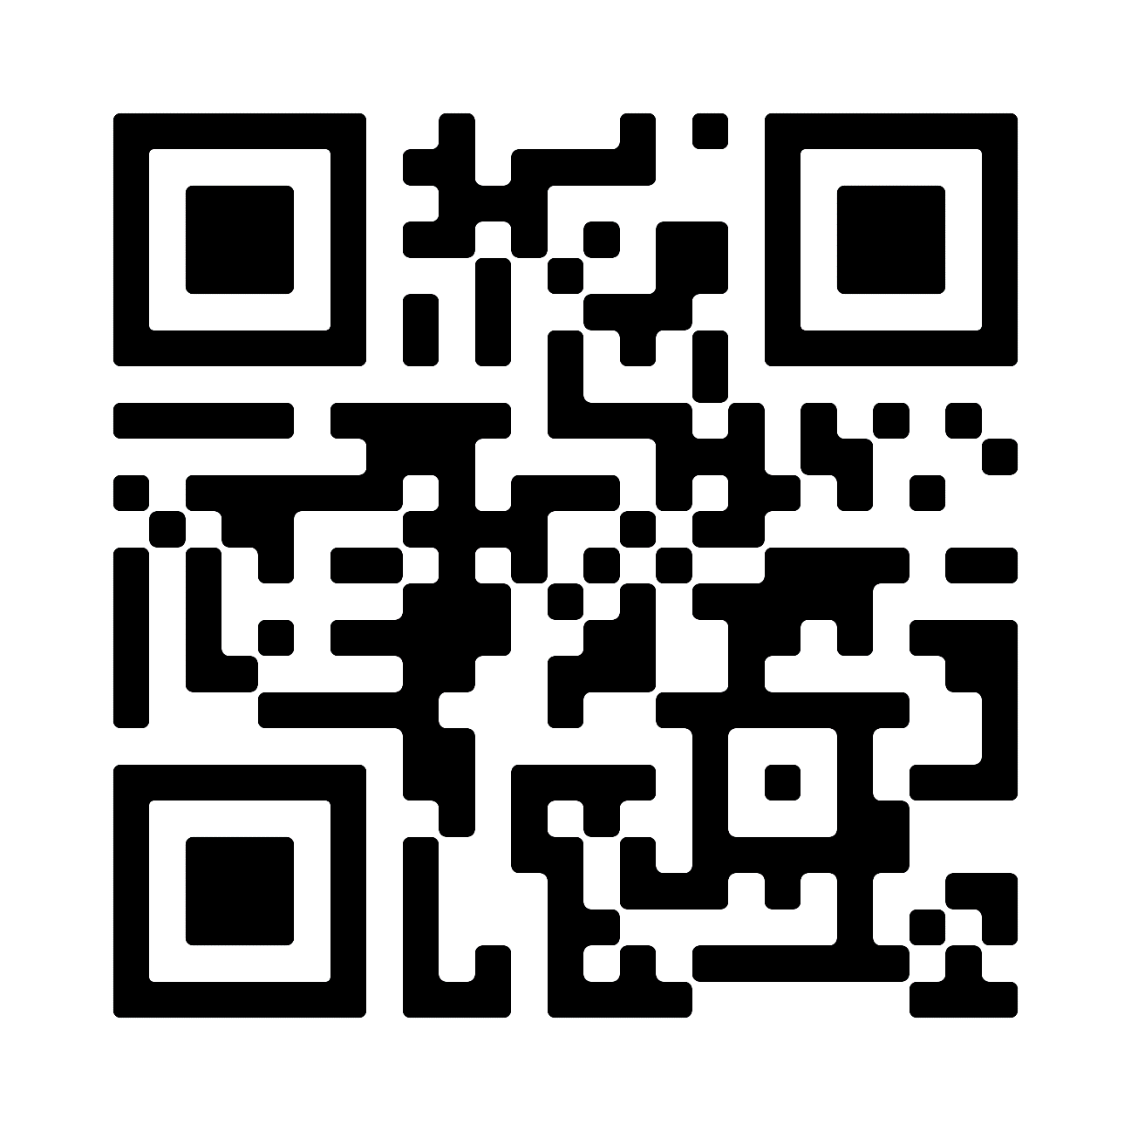


Leader Training Helps
Videos
Leader Portal - Training page
Returning Leaders
What’s New?
New Leaders
Ideal Year of Scouting
Unit Kickoff & Parent Buy-In
Leader Portal training
Storefront Best Practices
Storefront Reservations & Management
Managing Inventory
Sale Resources
Leader Portal - Training page
Leader Guide
Unit Program Planner
Scout & Parent Guide
Banner
Table Payments Sign
Scout Pitch
Q&A Webinars
Please watch the training videos before
Trail’s End experts will stay on and answer every question!

Slide 13
selling the product

Slide 14









Products
$25
$25
$25
$20
$17
$15
^{NEW}
Heroes & Helpers Donations
Donations in App will be automatically processed nightly & reflected on Unit orders, eliminating manual ordering, and saving time!
Products and flavors consumers purchase every day.
Fewer products simplifies the sale for Councils, Units & Scouts.

Slide 15


Pretzel Ordering info
Pretzel delivery information will be determined closer to September.

Slide 16

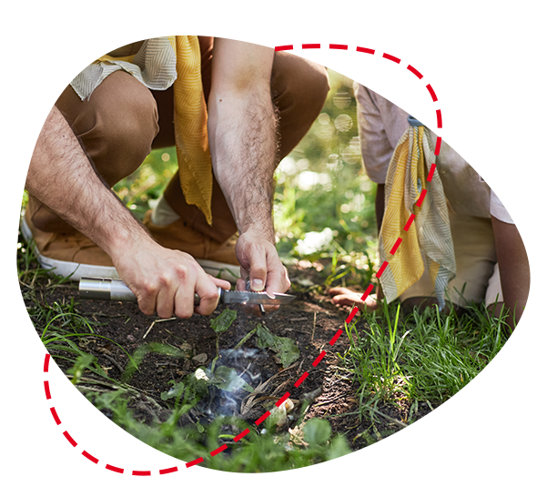

Ways to Sell
Storefronts
Setup tables at high foot traffic locations.
Scouts sell to customers coming in and out of stores.
Best Practice: One Scout and their parent per shift.
Wagon
Sell door-to-door
Best Practice: Bring product with you to avoid second trip to deliver.
Scouts can record undelivered orders in App.
Online
Sell virtually to family and friends by sharing your online fundraising page via social, email & text.
Product ships to the customer.
Safest way to sell!

Slide 17
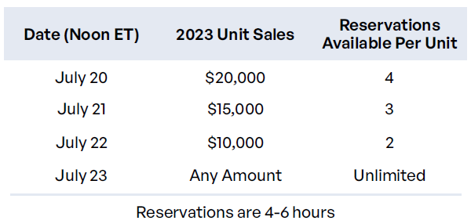
Trail’s End Storefront Settings & Reservations
Trail’s End Reservations
Trail’s End is reserving the best-selling times and storefronts for your Scout families!
Reserve on Storefront Reservations page.
Best hours will be highlighted.
Default Settings
Before reserving, set your split method.
Best practice: 2-hour shifts.
Notes:
One Scout and their Parents

Slide 18
Unit Booked Storefronts
Best practices when booking your own storefronts:
Determine high foot traffic days, times, and locations (Google Analytics)
Book as far in advance as you can
Visit the store in your Uniform with one or more Scouts
Shop the store, then request to speak with the manager
If permission is granted, ask for and notate expectations and follow the rules
Always say ‘Thank you!”
2 Scouts-2 Adults-2 Hours

Slide 19
Storefront Best Practices
Prep
Enough popcorn to sell $500 per hour.
A fully charged phone with the Trail’s End App.
Bluetooth Square reader
6-foot table & banner
Cash box with small bills.
Scout should use the restroom before shift.
Place products highest to lowest.
NEVER put prices on table.
Scout Role
Wear your uniform.
Stand in front of the table.
Smile & walk up to everyone.
Look the customer in the eye and give your pitch.
Guide them to the table to pick their products.
It helps to memorize the prices!
Let your parent handle the money so you can get more customers.
Parent Role
Encourage your Scout to keep asking. No’s happen, that’s okay!
Handle table and products setup.
Stand and thank everyone!
Share what your Scout will get with the consumers’ support.
Enter orders so your Scout can get more customers.
Submit all donations in App.
Notes:
Parent Pay Now & Heroes & Helpers

Slide 20
Ordering Info
    SHOW AND DELIVER (WAGON) ORDER DUE Aug 29 at Midnight
    Order through the Leader Portal at www.trails-end.com
    Up to 90% of what you sold in 2023 (Retail dollars)
    Order in full cases only
    We WILL have more product during the sale to check out.
    TAKE ORDER DUE SUNDAY NOV 10 AT MIDNIGHT
    Order through the Leader Portal at www.trails-end.com
    Can order singles
    Order your Hometown Heroes credits at take order
    NOTEABLE FEATURES
    What to order auto populate button
    Multifactor Authentication – 30 days
    Ordering for two Units

Slide 21
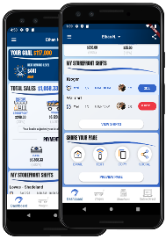
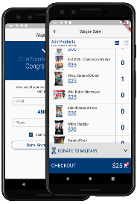
Online Direct
SHARE YOUR PAGE
Share your fundraising page
via email, text, or social media.
Customers click your link to place online orders.
Products ship directly to your customer’s home.
DIRECT ORDERS
Pick your products.
Credit or debit payments only
Products ship directly to your customer’s home.

Slide 22


Online Best Practices
Safe & Easy
Trail’s End ships the product directly to the customer.
No handling of products or cash for Scouts or Unit.
As many traditional products and prices as possible.
Additional products online.
Customize Page
Upload a profile picture.
Write a description - “Tell your customers why they should support Scout fundraising.”
Select your favorite product.
Share
Share your online fundraising page link with family and friends!
Use the App to post on social, send emails and texts & generate a QR code.
Follow-up with customers who have not bought.
Notes:
Parent Pay Now & Heroes & Helpers

Slide 23




Credit Cards
Credit is Best for Scouts
Safer, easier & higher sales for Scouts!
Trail’s End pays all fees!
Ways to accept credit in App:
      Square Bluetooth - contactless cards, chip cards, Apple Pay & Google Pay
      Square Swipers: Lighting (Apple) & Headphone jack (Android)
      Manual Entry (no reader): type card
      Apple Pay, Google Pay & Cash App Pay: use share feature at checkout for customers to pay on their device!
^{NEW}
Cash to Credit
Parents
Use their card and keep the cash.
Available at end of shift (up to 30 minutes after).
Scouts earn more Rewards.
Leaders
Use their card and keep the cash.
Available after shift until 2:59am ET.
Scouts earn more Rewards.

Slide 24
Distribution

Slide 25
Distribution
Show and Deliver Pick Ups
  Sept 12
  Several Locations Around Council
Reordering Starting Tues Sept 24 Pick up at reorder warehouse or Snack Semi
Home Delivery
  Over $15,000 in sales in 2023
  Must order at least $7,000 or 35% of last year’s sale (whichever is greater)
  Need home Delivery Info by Aug 29. We will send out a survey to request the info

Slide 26
Distribution
EARLY RETURNS
Sunday Oct. 6 and Monday Oct 7 4-7p.m.
No questions asked
  Units can only return FULL Cases of product at early return days.
  Units will only be able to return up to 15% of their TOTAL Show and Deliver order after Oct 7.
FINAL RETURNS—up to 15% of what physical product you have checked out on Nov 10.
Sunday Nov 10 4p.m.-7p.m.
4 Locations on Sunday
Willmar by appointment.
ABSOLUTELY NO RETURNS AFTER NOVEMBER 10

Slide 27
Ordering more — Snack Semi/warehouse
During the sale for reorders you can order from the warehouse OR the Snack Semi.
The Snack Semi is similar to the Amazon Treasure Truck
Order by a certain date each week for pick up around the metro and outlying areas.
Order in full cases
3 days will have stops in 5-7 communities for 30 min before moving on.

Slide 28
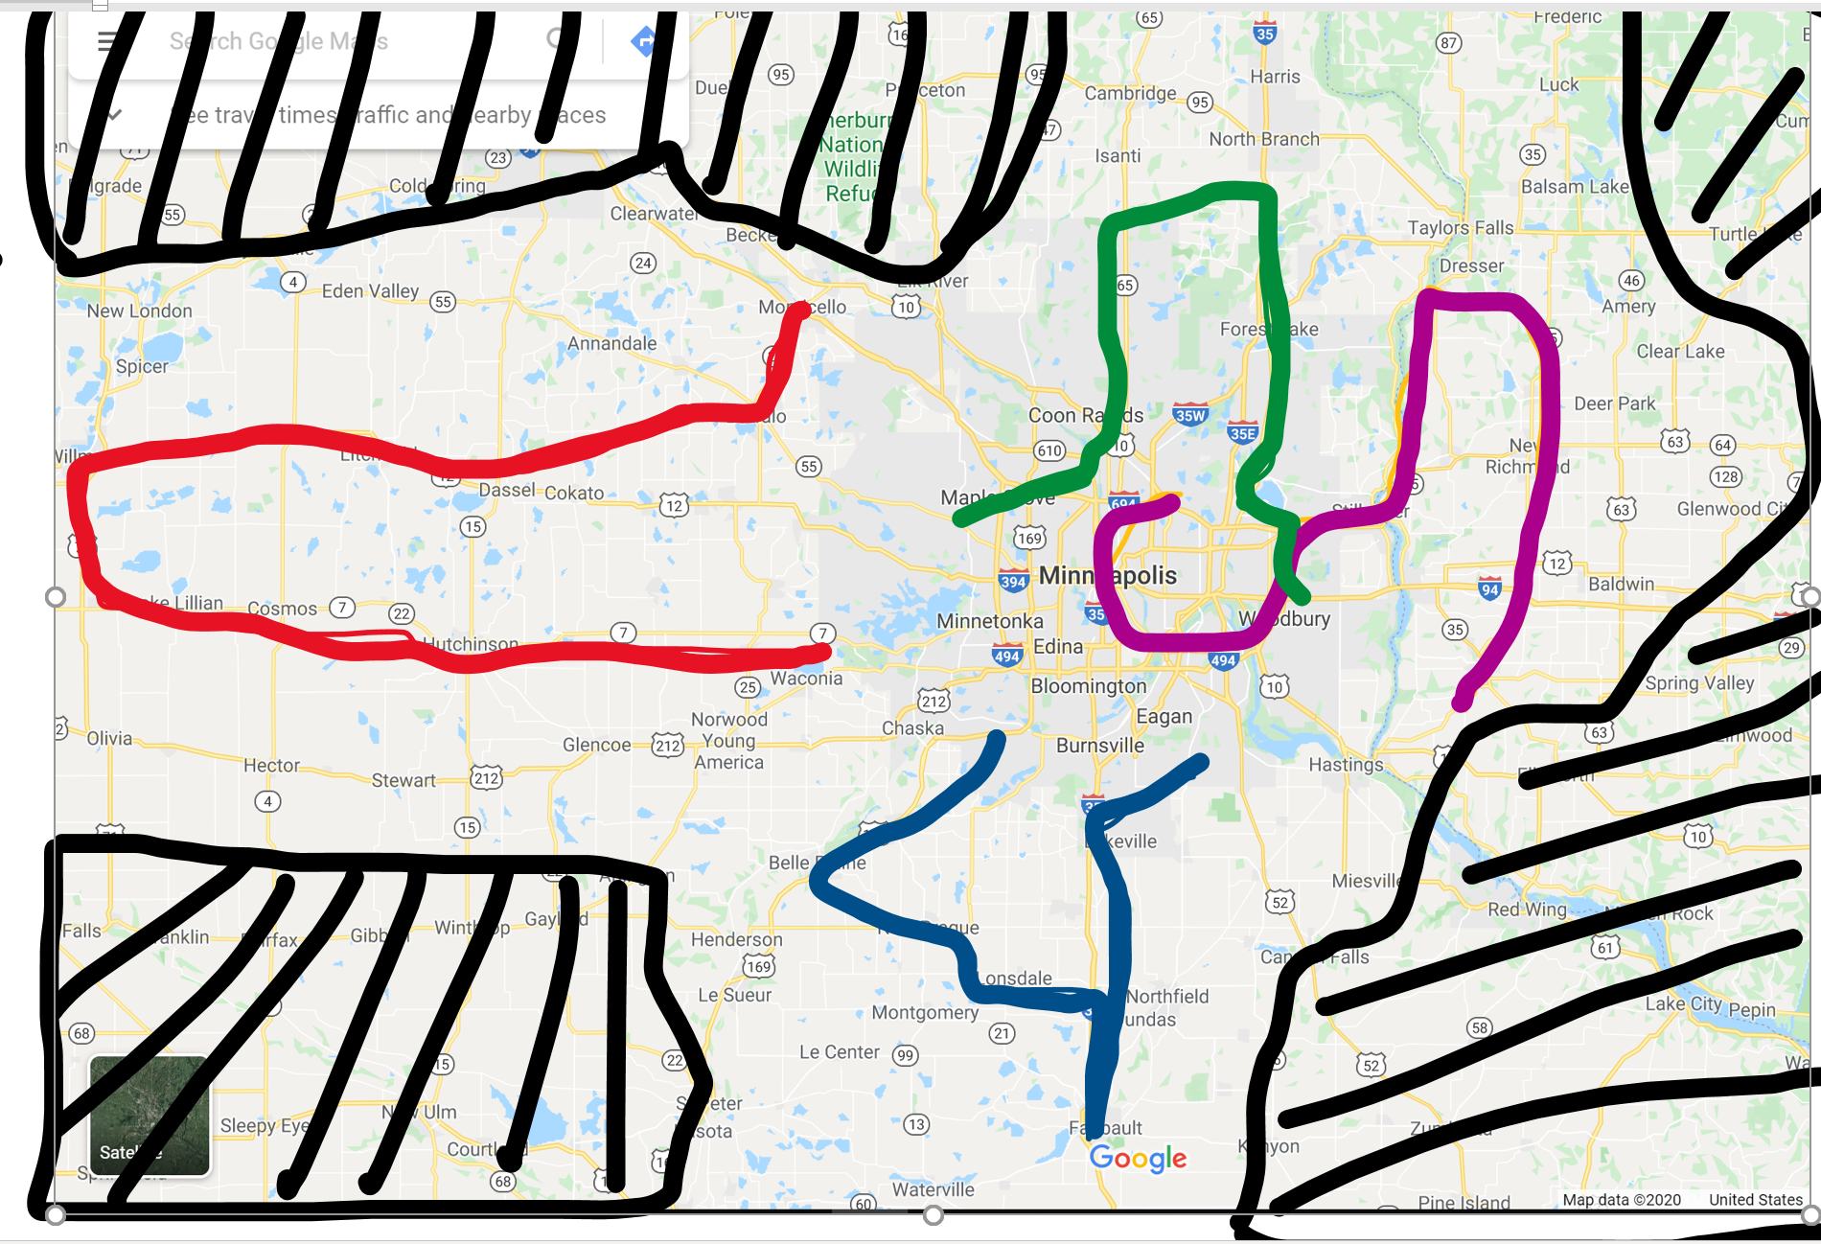
ROUTE 2
ROUTE 1
ROUTE 3
ROUTE 4

Slide 29
Transfers
All Transfers are done through the
Trail’s End Leader Portal
You can initiate a transfer
Both parties have to accept
Invoice automatically updates for both Units

Slide 30
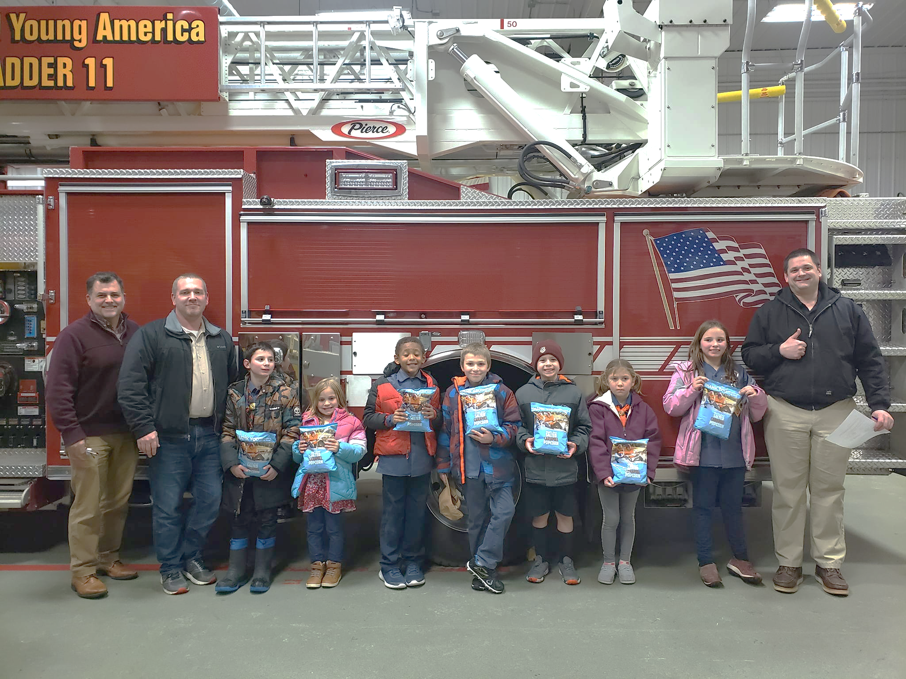
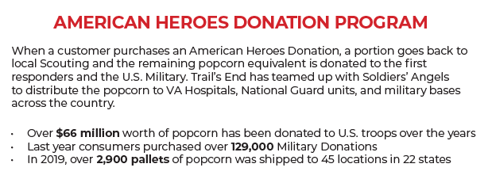
Hometown Heroes
Return product is used to fill our local Hometown Heroes orders
In 2023, over $104,000 was given to local heroes!

Slide 31
Prizes!

Slide 32
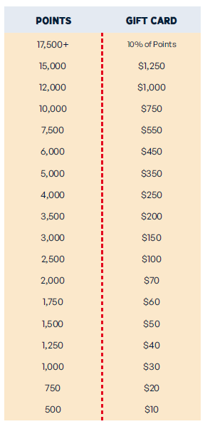
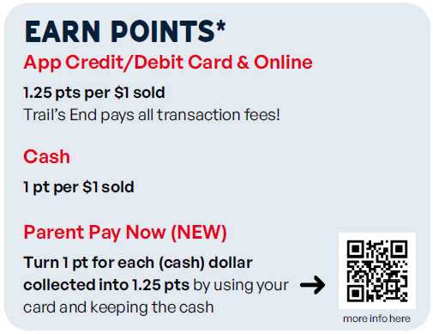
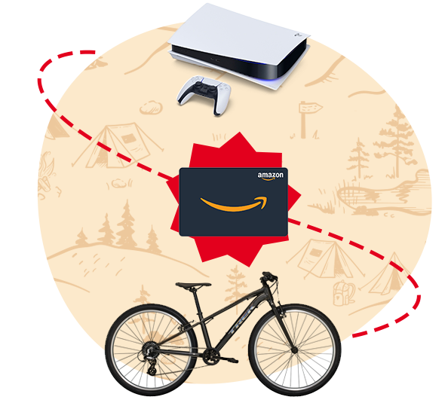

Scout Rewards
Scouts accumulate points towards Amazon eGift Cards when recording sales in the Trail’s End App.
Bonuses
Sell $500/hour per Scout for any 2 hour storefront shift or longer (July 1 – Dec 15) and earn 0.5 bonus points per $1 sold. To qualify, Unit must select – One Scout per shift split method.
Notes:
Make point values BIGGER; Parent Pay Now

Slide 33



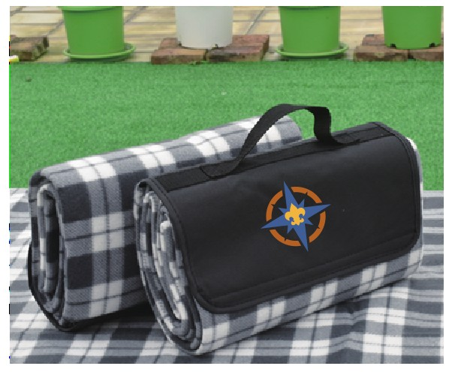
Bonus Prizes—a Northern Star Tradition!
• Bonus Prizes — (All units eligible) Will be at Take Order pick up.
Sell 1 Item— Patch
$850 Club — LED Camp Light and Fan
$1250 —NSC Branded Camping blanket
$1500—Hometown Heroes Family Day
$1900+ — Adventures!
$2500—Champions Breakfast January 11, 2025 at Base Camp.
Notes:
3 min

Slide 34



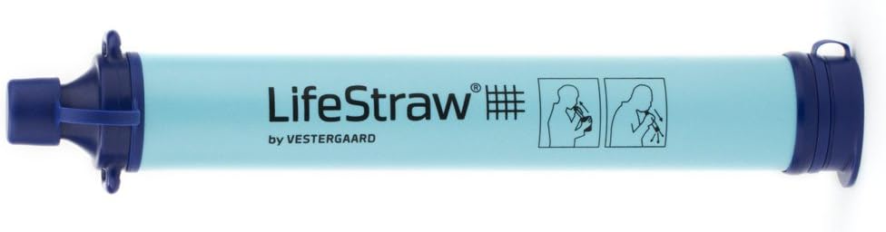



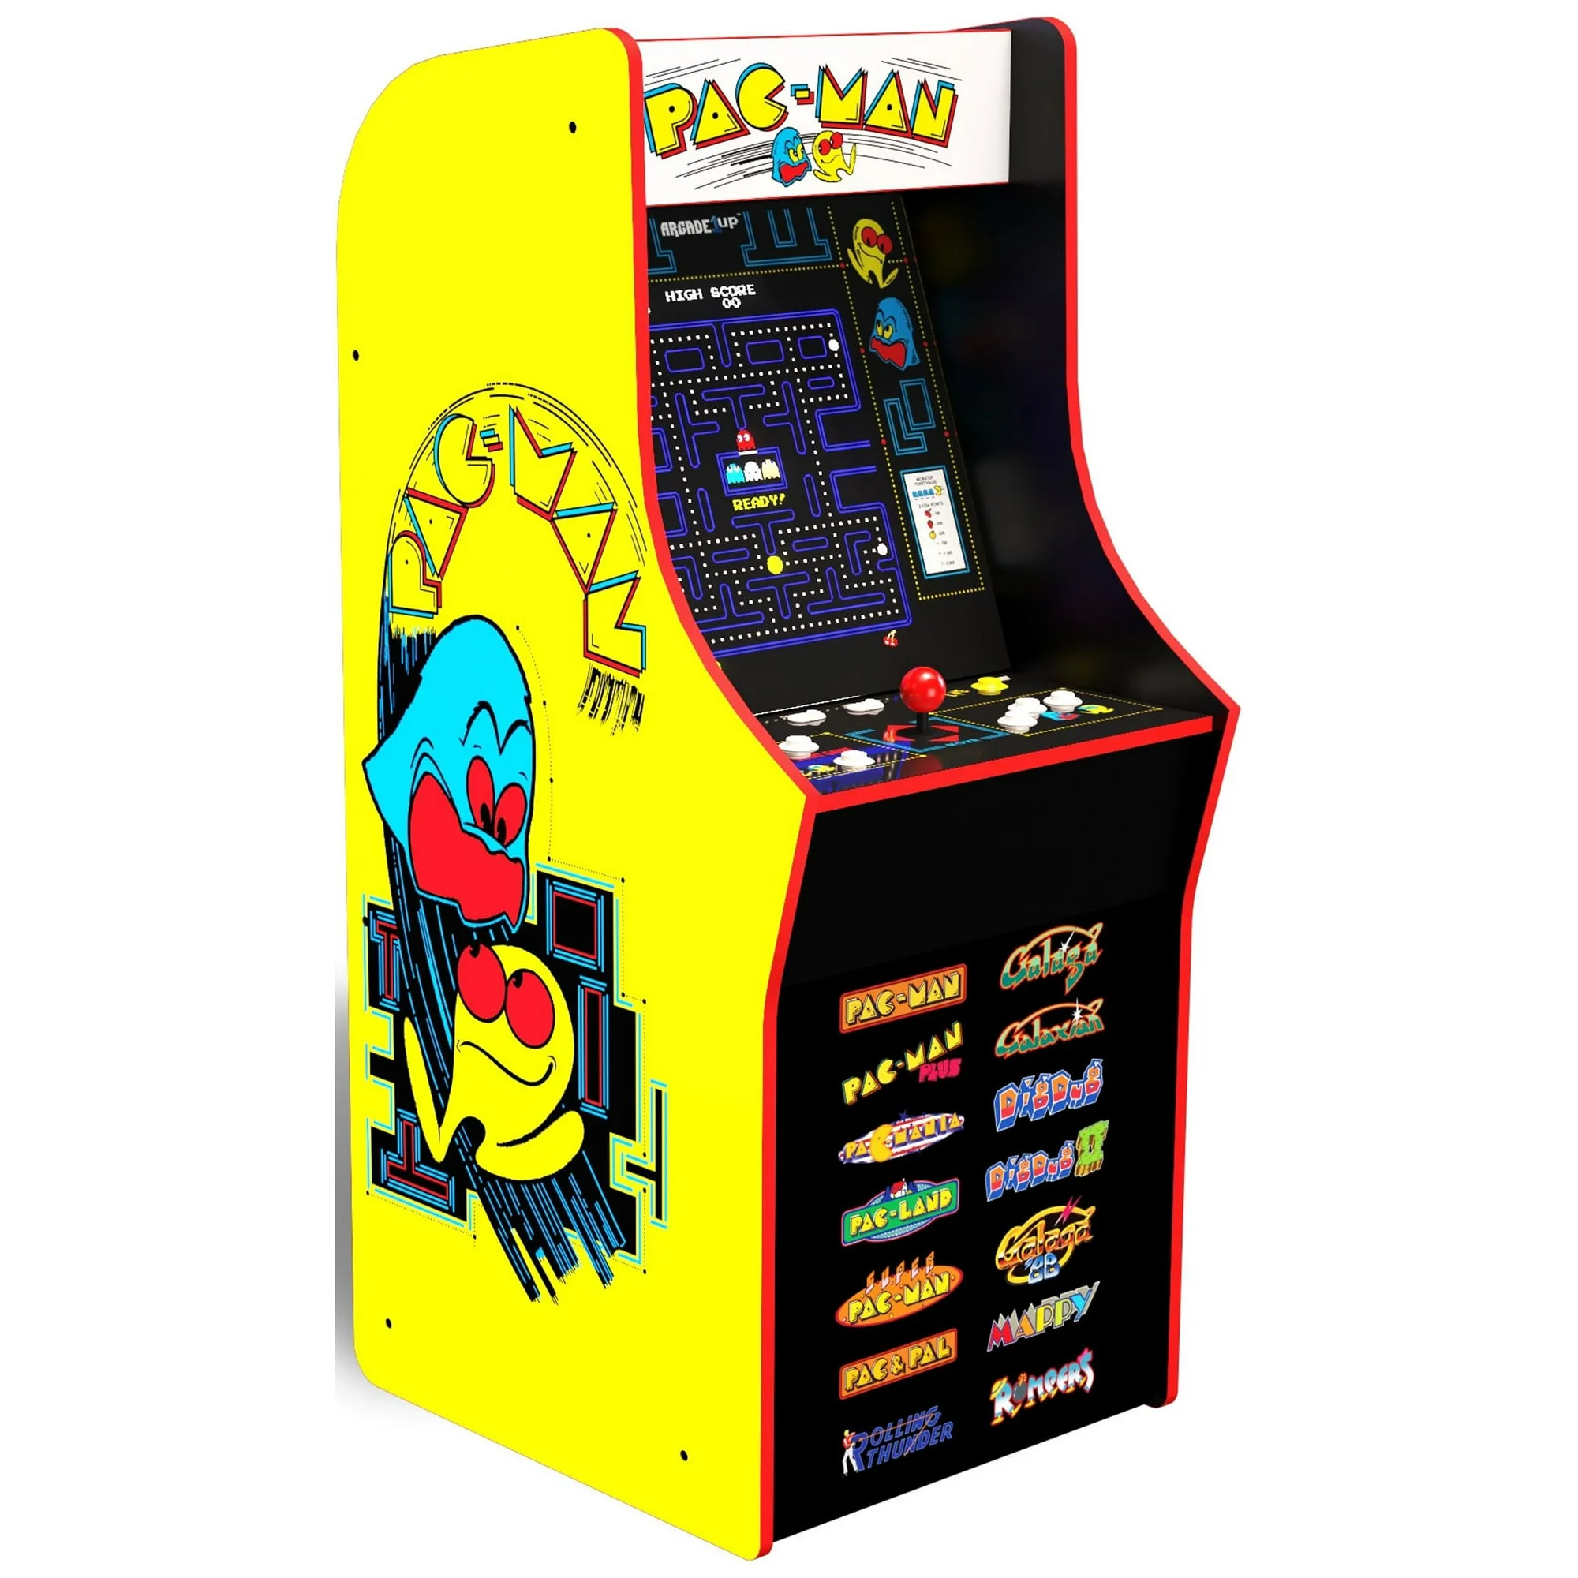
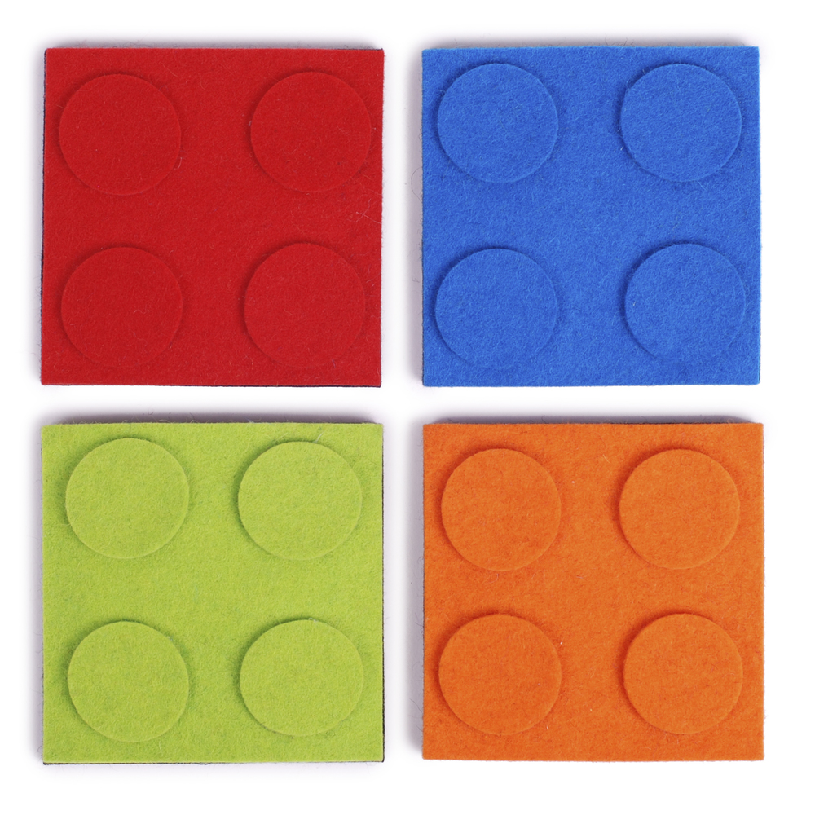
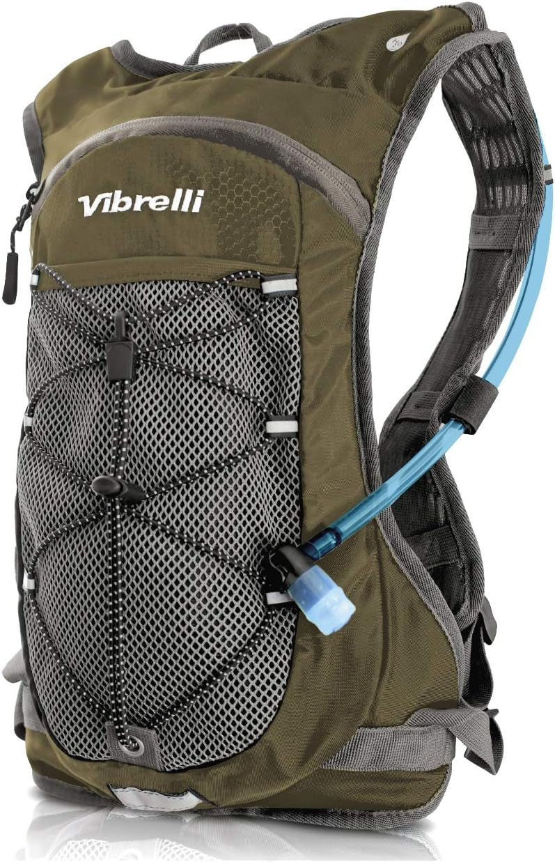
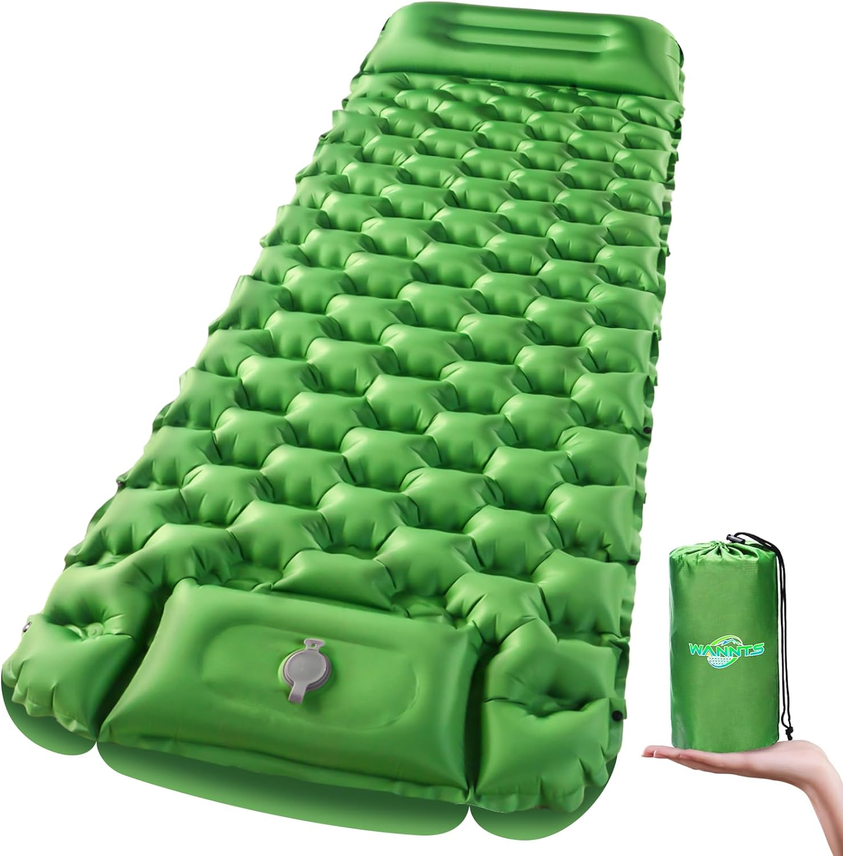


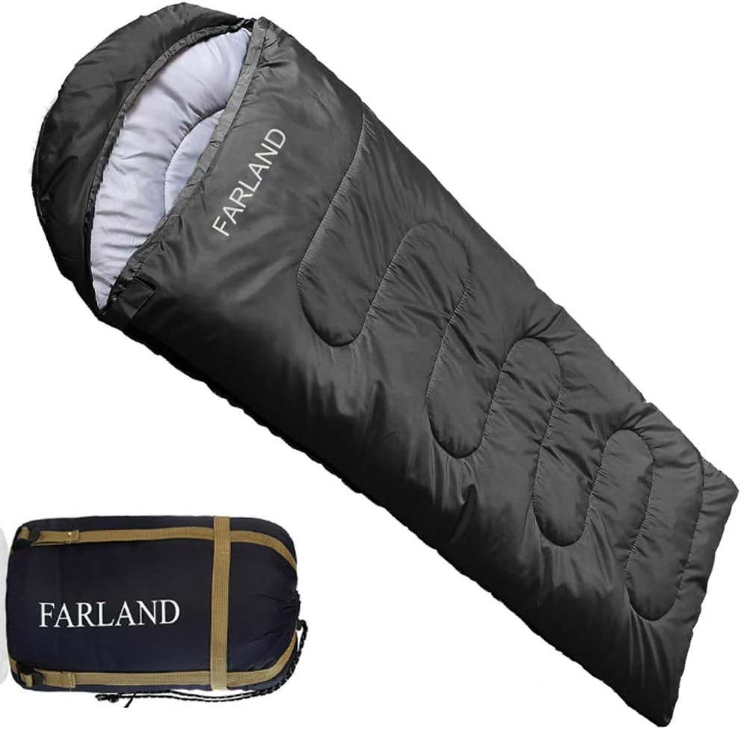


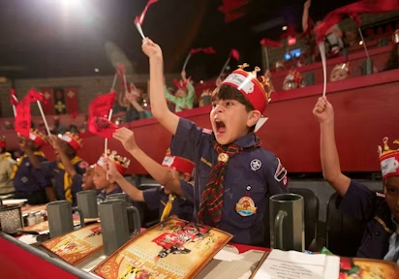


Adventures
Notes:
3 min

Slide 35
Resources

Slide 36
Unit Kick off
The Kick-off sets the tone for your popcorn sale. Motivated Scouts and, more importantly, motivated Parents are the key to a successful sale.
Make it FUN!
Explain WHY the money is needed
Give away prizes!
Have a Scout from last year talk about what they did
SPEND THE MONEY!
Notes:
1-2 min

Slide 37
Popcorn Festival
The Popcorn Festival is for all Scouts selling popcorn. Encourage all your Scouts to attend!
Base Camp
Date/Time: Open house style on Saturday, Sept. 14, 9:00 a.m. - 12:00 p.m.
Location: Base Camp—6202 Bloomington Road, Fort Snelling, MN 55111.
Stations: (subject to change)
Prize Extravaganza/Bonus Prizes/Adventures
Trail’s End App Practice Your Pitch
Hometown Heroes Storefront Safety
AND MORE!
.
All Scouts who preregister and attend the Popcorn Festival will be given an exclusive WOODCHUCK USA wooden memo pad
Emails with the sign-up information will be sent out early August to all registered Scouts in the Trails End app, as well as unit chairs. Emails will be sent to popcorn chairs to forward to parents and Scouts.
Notes:
1-2 min

Slide 38

What’s Returning??
Set your Goal—get chicken!
Any Scout who enters their goal in to the Trail’s End App by Oct. 1 will receive a certificate for a FREE kids meal from Raising Cane’s.

Slide 39

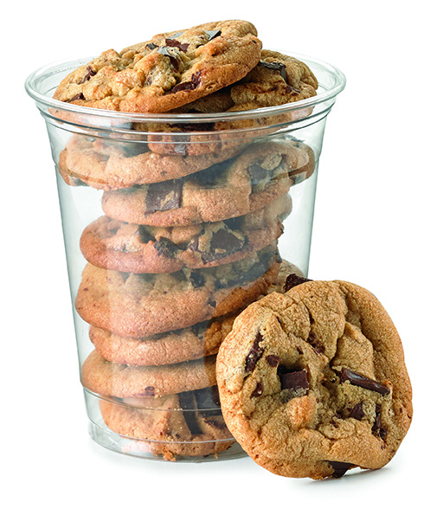
What’s New??
Sell $100 Get a cookie cup!
Any Scout who sells $100 or more will receive a coupon for a FREE Cookie Cup from Holiday/Circle K

Slide 40
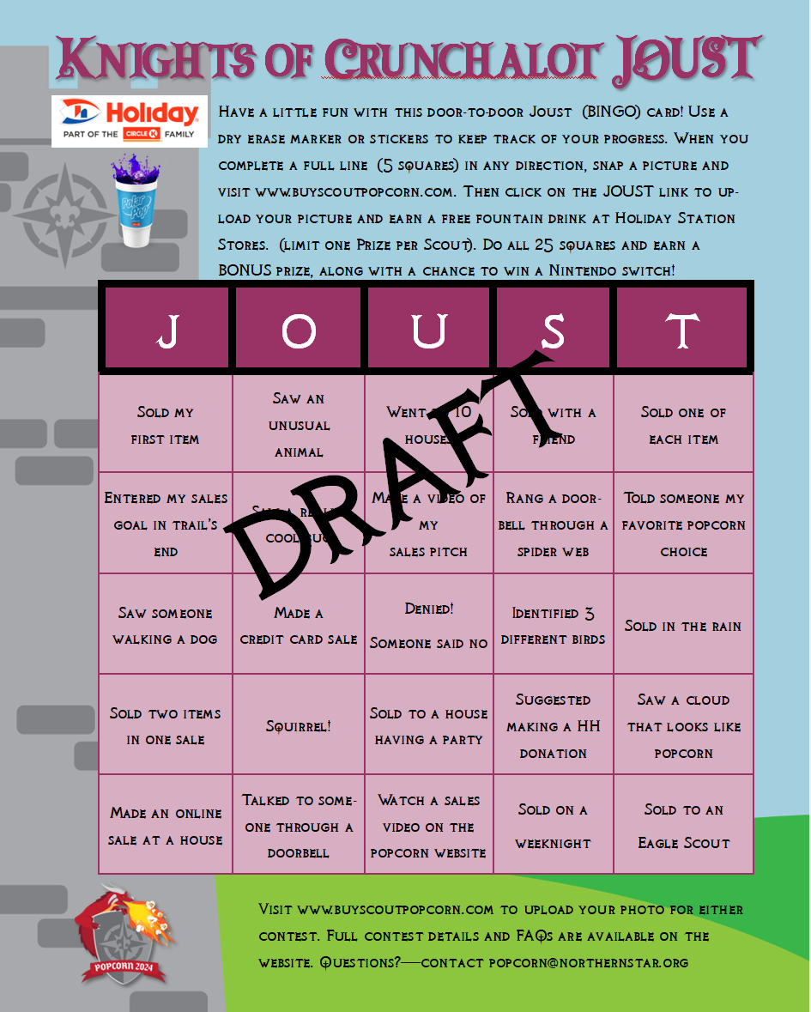

What’s New??
Play JOUST
Use the laminated sheet (Product line on the front, JOUST game on the back) and get 5 in a row in any direction and win a free drink from Holiday/Circle K
Get all 25 and earn a BONUS Prize and be eligible for prize drawings!

Slide 41
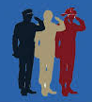
What’s New??
Hometown Heroes Event
Will be held at Base Camp in 2025
Will feature activities and games from local Military, Police, Fire, EMS and more!
Free for Scouts that sell $1500+ families are invited

Slide 42



What’s New??
2024 Popcorn
Sales Guide
Order Supplies
Sales Guides
Laminated Sheets
Banners

Slide 43
Payments
Payments are due Dec 13
1 Check from the Unit
No prepayments are needed
Check your Leader Portal for invoice, amount owed and if there are dollars in your payout section

Slide 44
Important Dates
2024 Popcorn Calendar
Pre-Sale Prep
July 20 Sign up for Storefront Sales in Trail’s End Leader Portal 11:00 a.m.
Thurs. Aug. 29 Show & Deliver Order Due at Trails-End.com 11:59 p.m.
Sat. Sept. 14 Road Rally– Council Kickoff—Base Camp 9:00 am.—12:00 p.m.
Sept. 12 Show and Deliver Popcorn Distribution Varies by Area
Sept. 10-18 Home Deliveries Dropped off Varies
During the Sale
Fri. Sept. 20 SALE STARTS! 5:00 p.m.
Sun. Oct. 6/Mon. Oct. 7 Early Returns - Full cases only 4:00 p.m.-7:00 p.m.
Sun. Nov. 3 SALE ENDS! 11:59 p.m.
After Sale Wrap Up
Sun. Nov. 10 Final Returns
Sun. Nov. 10 Take Orders Due MIDNIGHT
Nov. 21-22 Take Order Distribution Varies by area
Fri. Dec. 13 Payments Due Dec. 13

Slide 45
What should you do now?
Attend a Trails End Webinar
Survey your Scout parents to get a feel if they will sell
Log into the leader portal at www.trails-end.com
Create a storefront plan
Start planning your order
If you don’t have a working login/password, email popcorn@northernstar.org, make sure to include your Unit and Name.

Slide 46
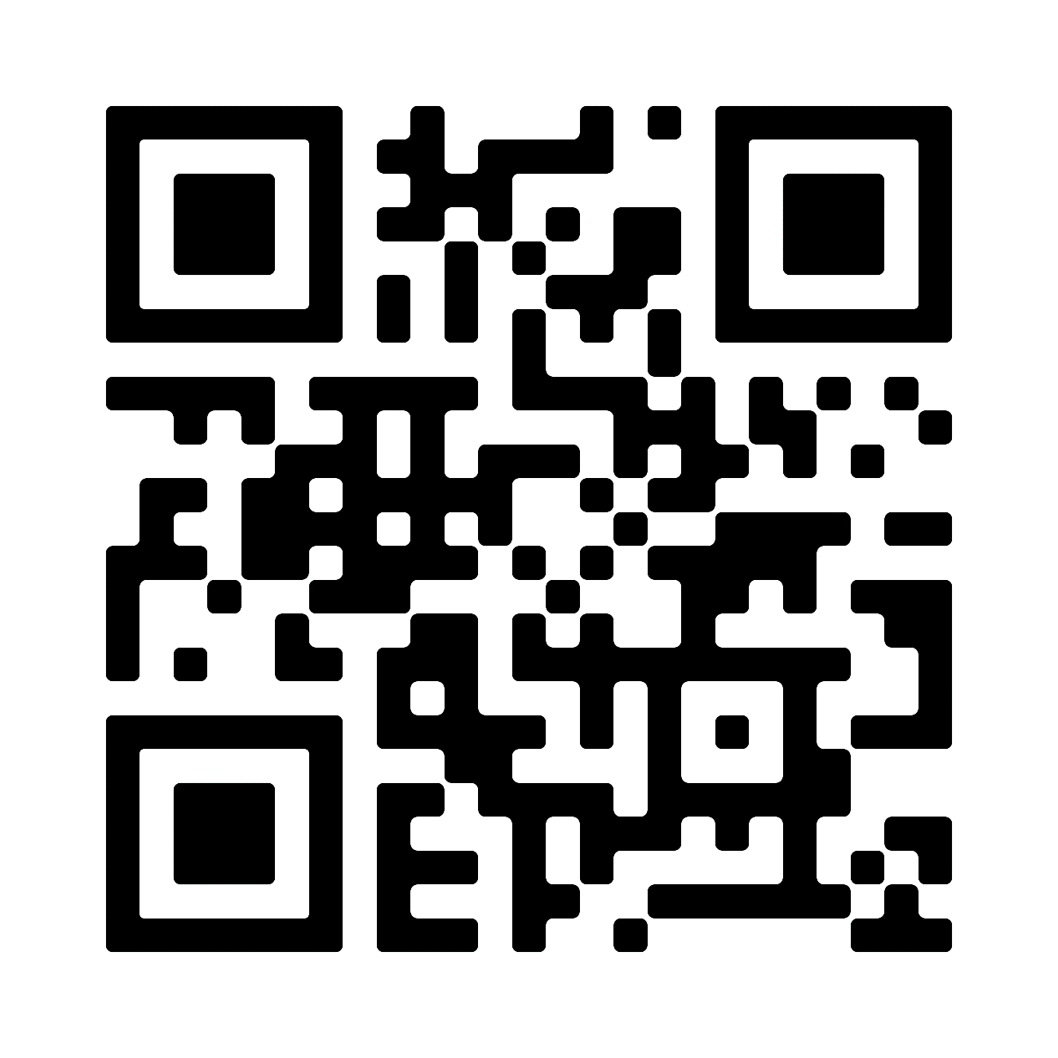
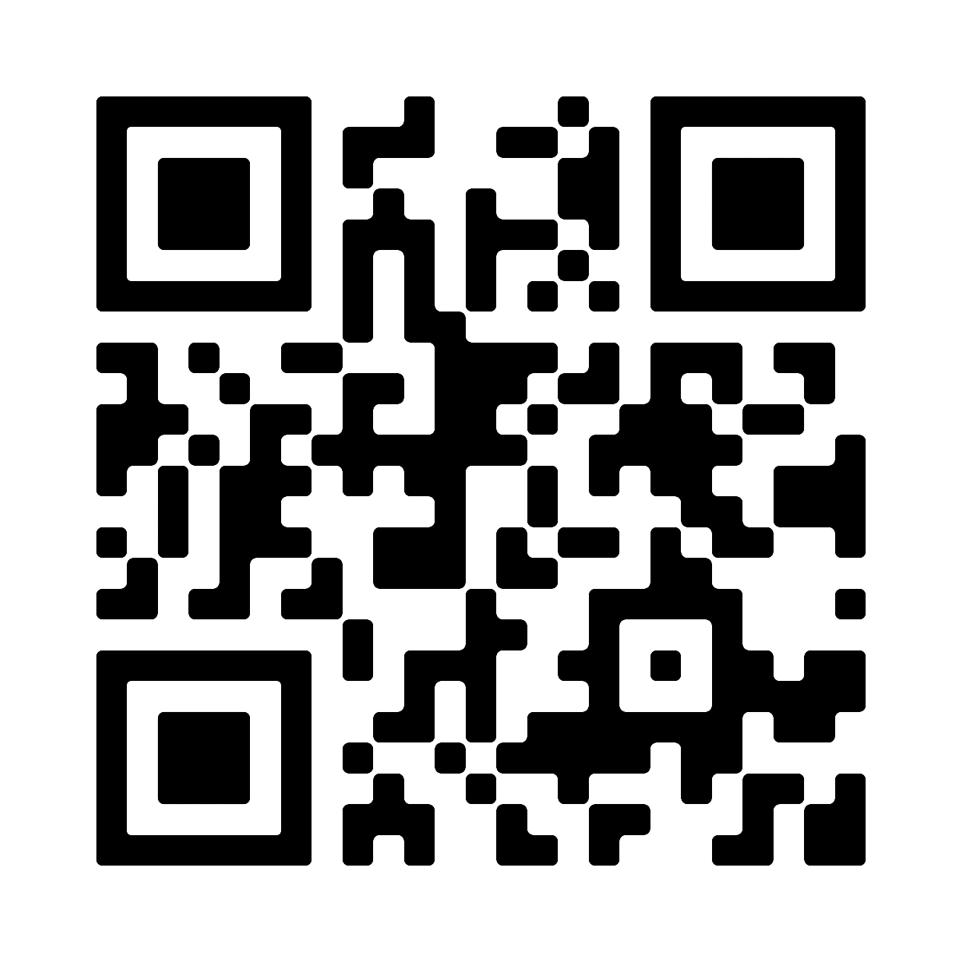
Support
Trail’s End Support
Visit our FAQ page for answers to commonly asked questions & to open a ticket.
Council Support
Bill Anderson-Horecka
Billa-h@northernstar.org
612-261-2405
Becki Whitaker
Bwhitaker@northernstar.org
612-261-2403
Popcorn Page:
www.buyscoutpopcorn.com
Facebook Group
Join Trail’s End Popcorn Community for best practices, support, news, and answers to questions.
Email: support@trails-end.com

